Slide 1
Title
Sub heading
Date

Slide 2
Title – Square Bullets
Daeperibus, quossi omnis aciis voluptas asin parciis magnatiae debissequi
Natempo exerfernam il id que dit aut lam etustin et facescitis que molore eum res aut quiatet es.
Daeperibus, quossi omnis aciis voluptas asin parciis magnatiae debissequi
Natempo exerfernam il id que dit aut lam etustin et facescitis que molore eum res aut quiatet es

Slide 3

Title – Arrow bullet
Daeperibus, quossi omnis aciis voluptas asin parciis magnatiae debissequi
Natempo exerfernam il id que dit aut lam etustin et facescitis que molore eum res aut quiatet es.
Daeperibus, quossi omnis aciis voluptas asin parciis magnatiae debissequi
Natempo exerfernam il id que dit aut lam etustin et facescitis que molore eum res aut quiatet es

Slide 4
Title – Chart example
Daeperibus, quossi omnis aciis voluptas asin parciis magnatiae debissequi
Natempo exerfernam il id que dit aut lam etustin et facescitis que molore eum res aut quiatet es.

Slide 5
Table example
 |  | 2014 Score | Difference %
Overall recommendation | 8.1 | 7.2 | +13%
Key Decision Makers recommendation
KDM (45 participants) | 8.0 | 7.3 | +10%
Non KDM (15 participants) | 8.2 | 7.1 | +15%
Seniority recommendation
Senior (35 participants) | 8.2 | 7.5 | +9%

Slide 6

Title - Full page Image

Slide 7
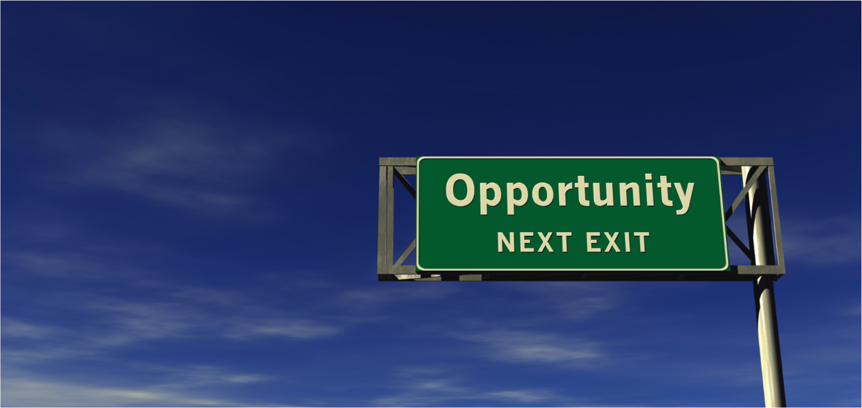
Title – Half page image
Body copy Daeperibus, quossi omnis aciis voluptas asin parciis magnatiae debissequi
Body copy Daeperibus, quossi omnis aciis voluptas asin parciis magnatiae debissequi

Slide 8

Title – 2 images

Slide 9
Divider Add title here

Slide 10
Statement page – one sentence

Slide 11
Shapes
Add text
Add text
Add Text
Add Text

Slide 12
Colour

Slide 13
Font
Tahoma
Heading pt 20
Body copy pt 14

Slide 14

What do your clients think?
Presentation to McCann World Group on Wave 3 of the Client Interview programme
December 2022

Slide 16

Agenda
Introduction
Management Summary
Overall conclusions
Client Commitment Index®
RADAR® summaries
Word Cloud
One piece of advice
Animal personifications
Overall Indicated action
Detailed Client Viewpoint
Appendices
Quantitative highlights
© 2022 Relationship Audits & Management®

Slide 17
Introduction
Interviewee | Company | Date of Interview
Gabriel Ladaria | IKEA | 16-11-2022
Mathieu Desbrandes | Reckitts UK | 27-10-2022
Pankaj Duhan | Reckitts Global | 08-11-2022
Michalis Moschos | Microsoft CEE | 11-11-2022
Benjamin Combe | Nespresso | 28-10-2022
Cristina Sacca | Mastercard | 18-11-2022
Michael Flatt | X-Box / Microsoft | 09-11-2022
Kirk Collingwood | Aramco | 15-11-2022
Rabia Jaffer | Direct Line Group | 17-11-2022
Pending Interviews | Company | Date of Interview
Alex Allcott | eBay | 05-01-2023
Venessa Hodgson | HSL Chairs | To be arranged
Interviews undertaken October to November
9 Client Companies (RB UK & Global)
9 Individuals
Two ‘repeat’ from wave 2
Pankaj Duhan, Reckitts Global
Michalis Moschos, Microsoft
© 2022 Relationship Audits & Management®

Slide 18





Introduction- The Questions
5 Key Performance Areas
Proven over time and across geographies
Designed to
Identify SWOTs
Uncover Client Commitment
Opinion
Intention
Combination of
Open ended
Semi structured
Relationship
Attitude
Delivery
Added Value
Recommendation
© 2022 Relationship Audits & Management®

Slide 19
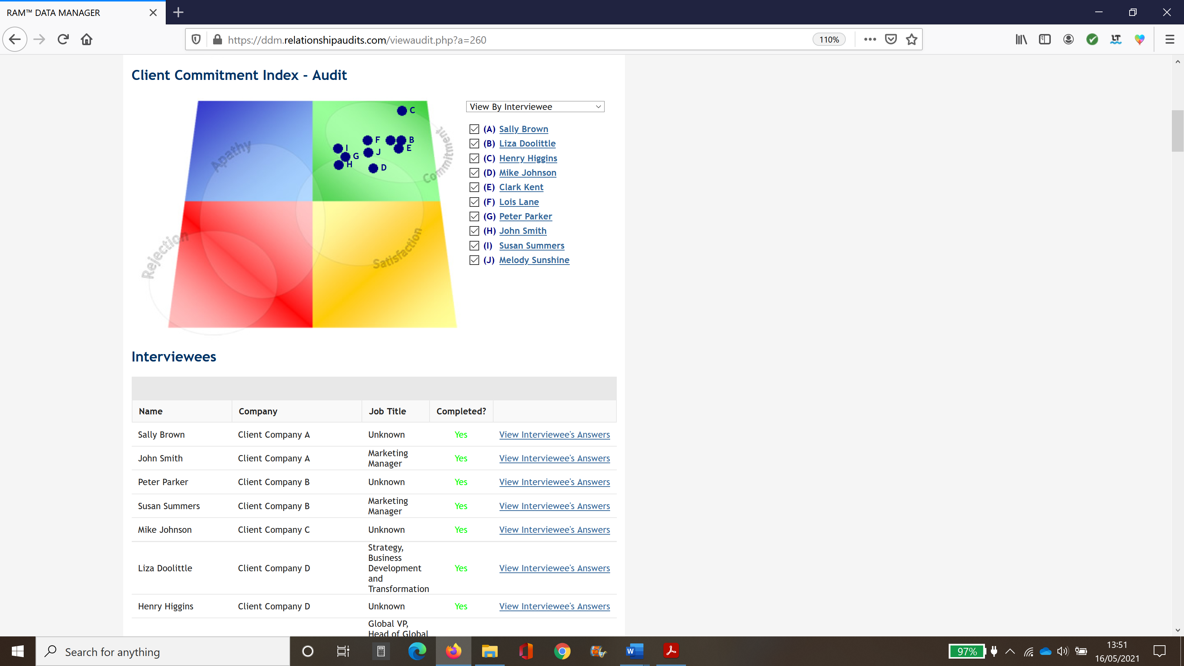
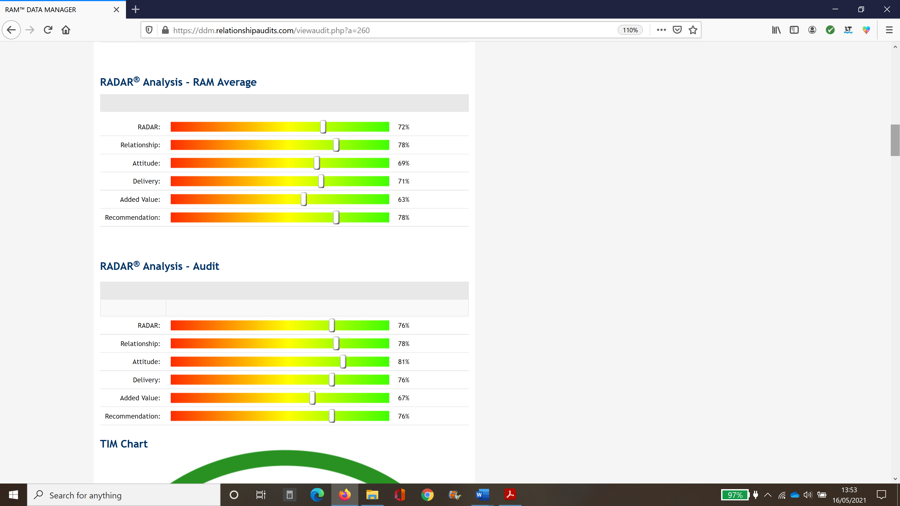
Reporting
Narrative
Graphic
Expectations and performance
Going well/needs attention
Competitive context
People and relationships
Attitude and effort
Quality of input/output
Value and added value
Future needs
Advocacy
Comparison with Relationship Audits benchmarks
© 2022 Relationship Audits & Management®

Slide 20
Management Summary
Overall Conclusions
Client Commitment
RADAR® scores
Overall themes
Going well
Needs Attention
Changes vs previous waves
Overall Recommendations
© 2022 Relationship Audits & Management®

Slide 21
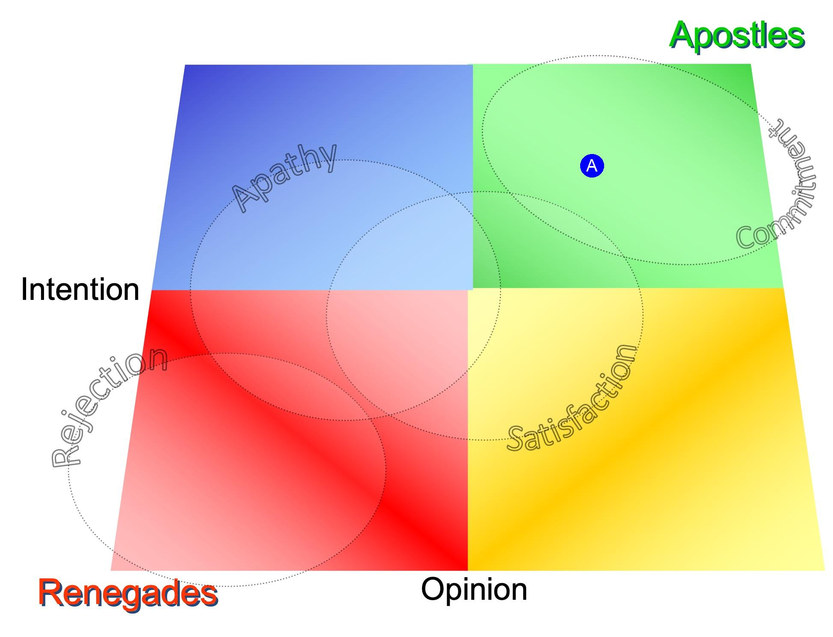
The Client Commitment Index® (RAM Overall)
(A) RAM Overall
© 2022 Relationship Audits & Management®

Slide 22

The Client Commitment Index® (Wave 3 Audit Average)
(A) Audit Average
© 2022 Relationship Audits & Management®

Slide 23
Client Commitment compared - RAM Overall vs Audit Average
RAM Overall
MWG Wave 3 (2022)
(A) RAM Overall
(A) Audit Average
© 2022 Relationship Audits & Management®

Slide 24
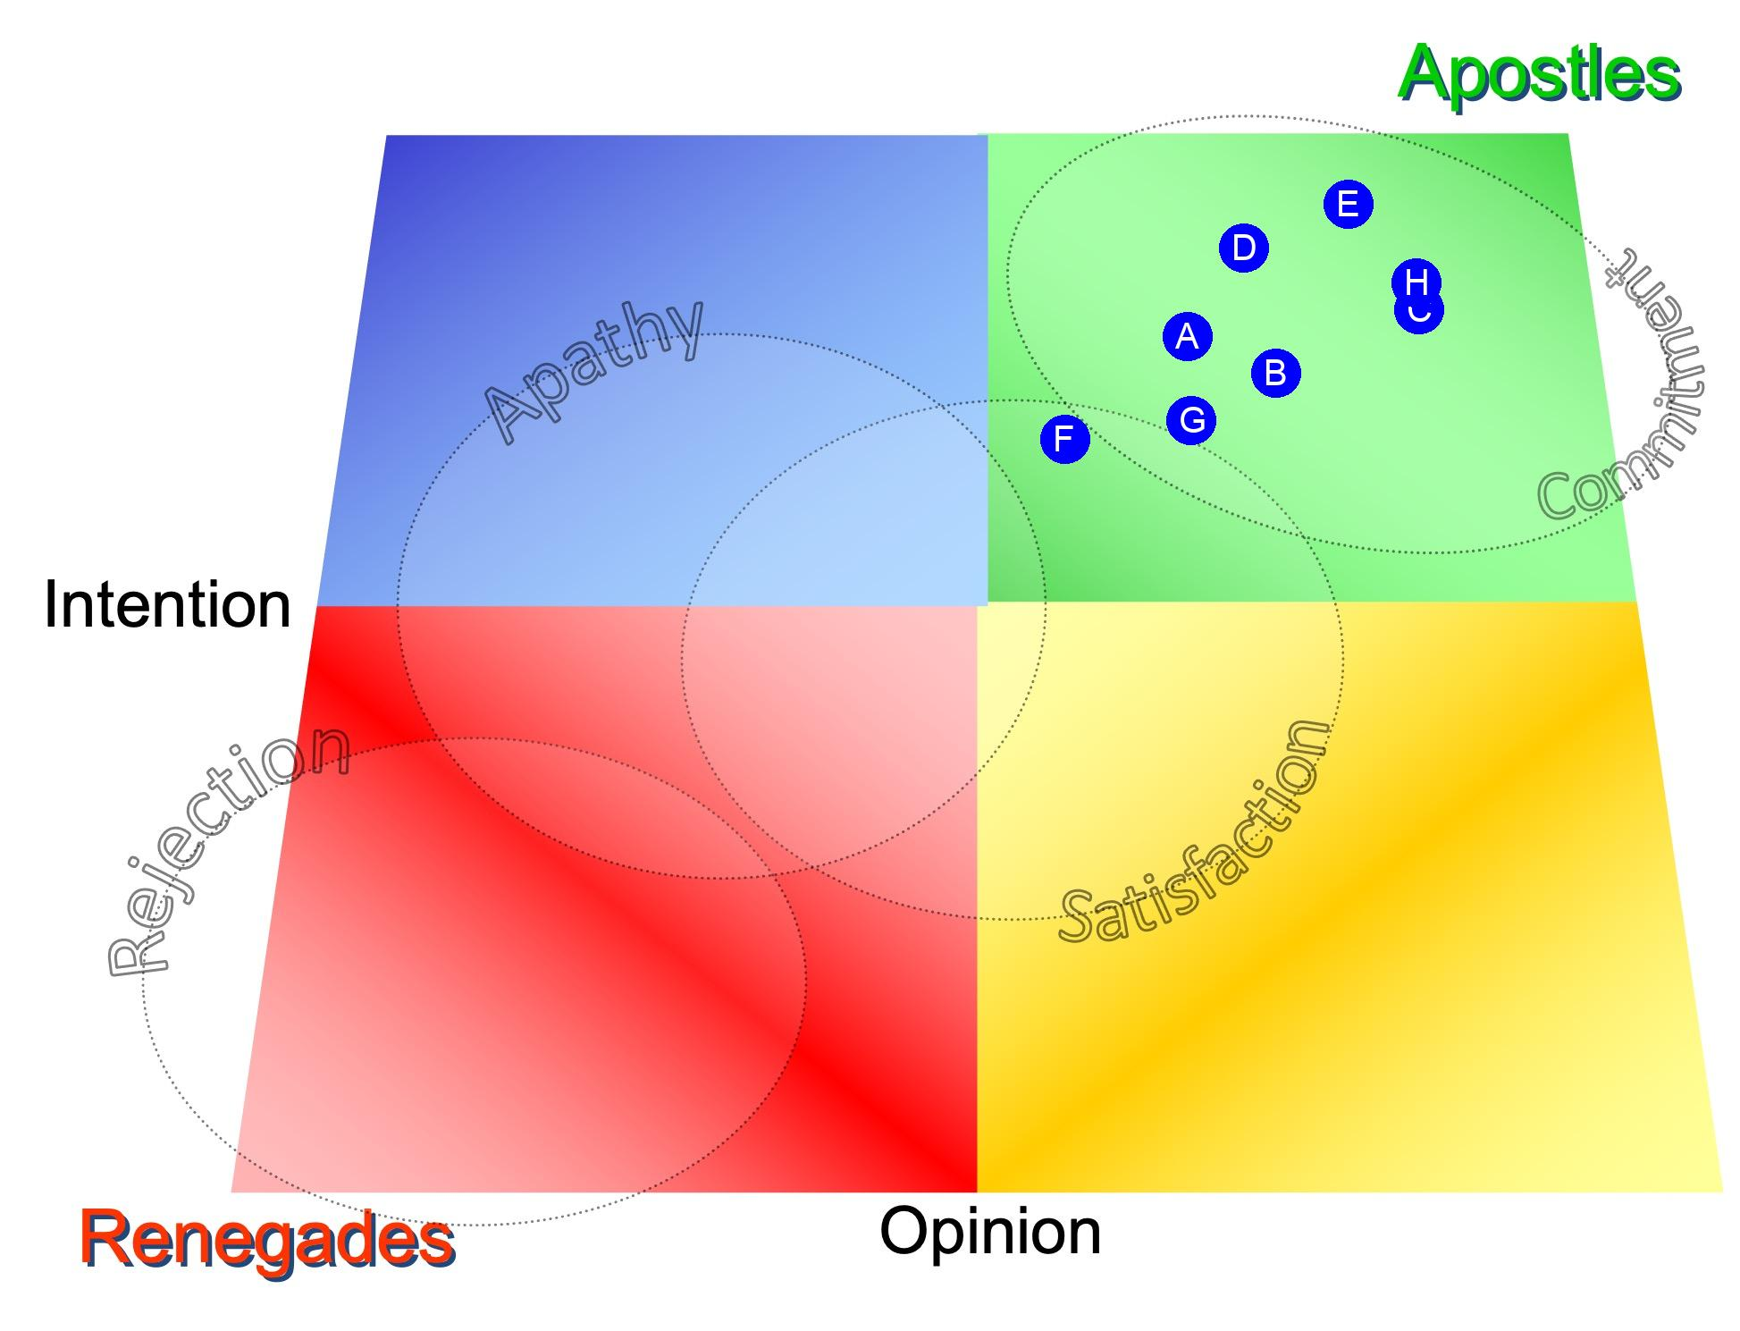
The Client Commitment Index® (Wave 3 Client Companies)
(A) Aramco
(B) Direct Line
(C) Ikea
(D) Mastercard
(E) Microsoft
(F) Nespresso
(G) Reckitt Benckiser
(H) X-Box
© 2022 Relationship Audits & Management®

Slide 25
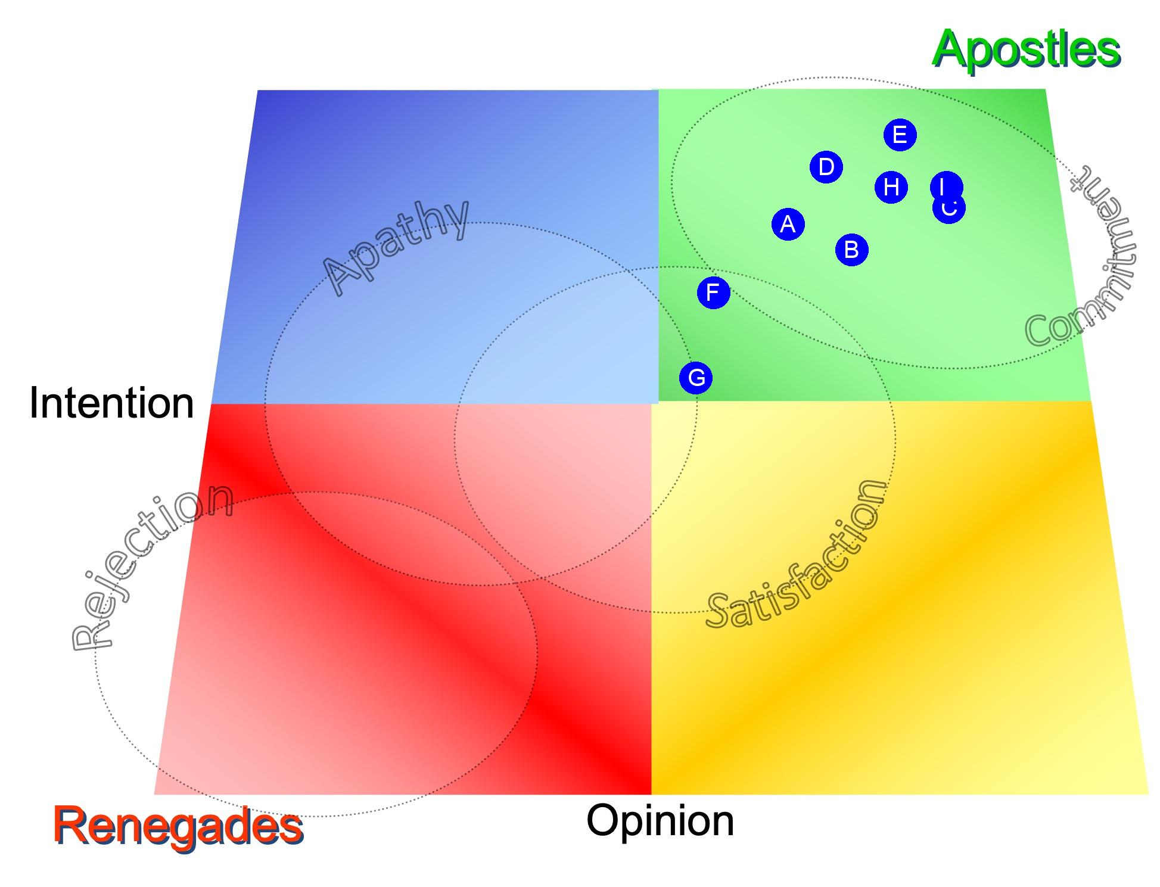
The Client Commitment Index® (Wave 3 Interviewees)
(A) Kirk Collingwood
(B) Rabia Jaffer
(C) Gabriel Ladaria
(D) Cristina Sacca
(E) Michalis Moschos2
(F) Benjamin Combe
(G) Mathieu Desbrandes
(H) Pankaj Duhan 2
(I) Michael Flatt
© 2022 Relationship Audits & Management®

Slide 26
Company vs Individual Commitment- MWG Wave 3 (2022)
Client Companies
Interviewees
(A) Aramco
(A) Kirk Collingwood
(B) Direct Line
(B) Rabia Jaffer
(C) Ikea
(C) Gabriel Ladaria
(D) Mastercard
(D) Cristina Sacca
(E) Microsoft
(E) Michalis Moschos2
(F) Nespresso
(F) Benjamin Combe
(G) Reckitt Benckiser
(G) Mathieu Desbrandes
(H) X-Box
(H) Pankaj Duhan 2
(I) Michael Flatt
© 2022 Relationship Audits & Management®

Slide 27
RADAR® Analysis (RAM Average)
© 2022 Relationship Audits & Management®

Slide 28
RADAR® Analysis (MWG Wave 3 Audit Average)
© 2022 Relationship Audits & Management®

Slide 29
RADAR® Scores - Overall RAM vs Wave 3 Audit Average
Overall RAM
MWG Wave 3 (2022)
© 2022 Relationship Audits & Management®

Slide 30
Conclusions / Themes
What’s going well
What needs attention?
Comparisons with previous waves
© 2022 Relationship Audits & Management®

Slide 31

What’s going well?
Agency seen to
be dependably good at original core competence
strategy and creative
build strong relationships (people and chemistry)
have well-led teams
be responsive, accessible and collaborative
add value in varying amounts
make the clients feel valued
And improvements seen by those who took part in waves 2 & 3
© 2022 Relationship Audits & Management®

Slide 32
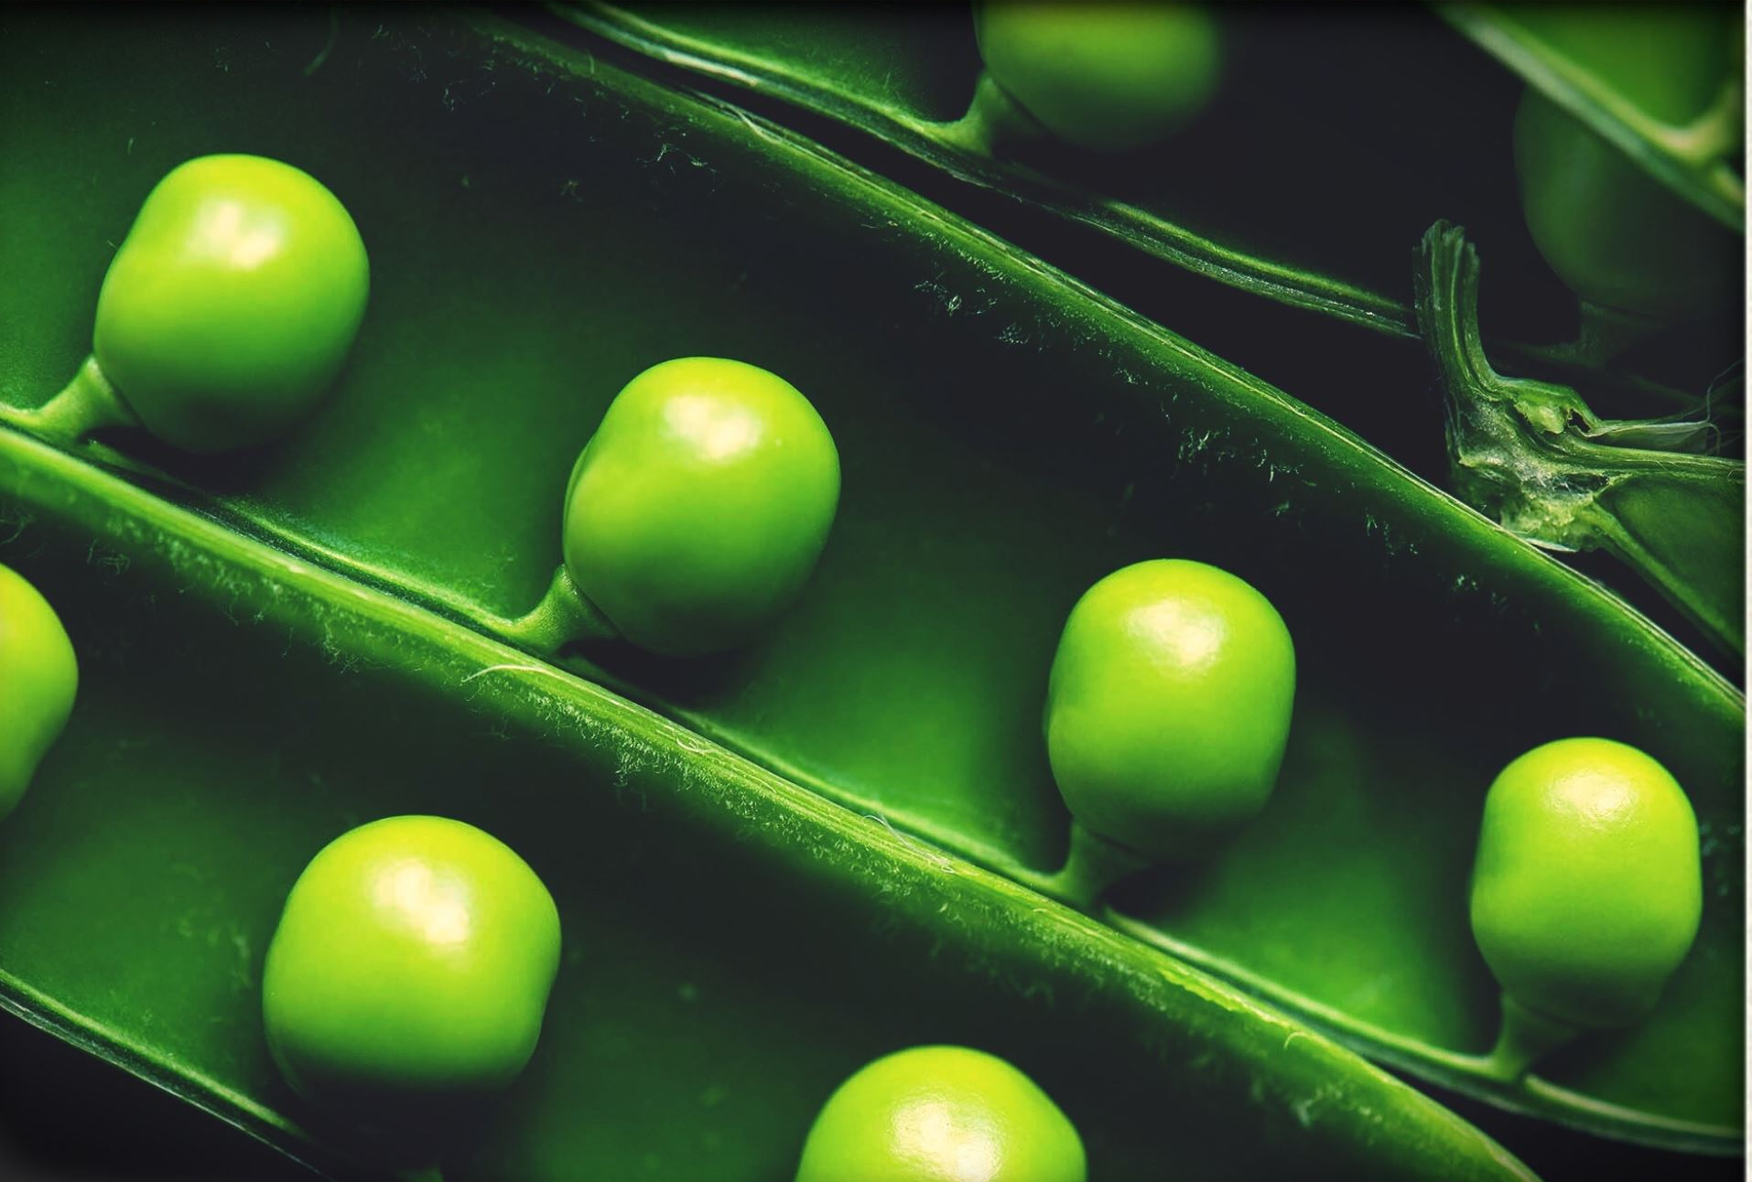
Overall Conclusions- What’s going well
© 2022 Relationship Audits & Management®

Slide 33

Differences versus Wave 2
1. Difference 1
xx
© 2022 Relationship Audits & Management®

Slide 34
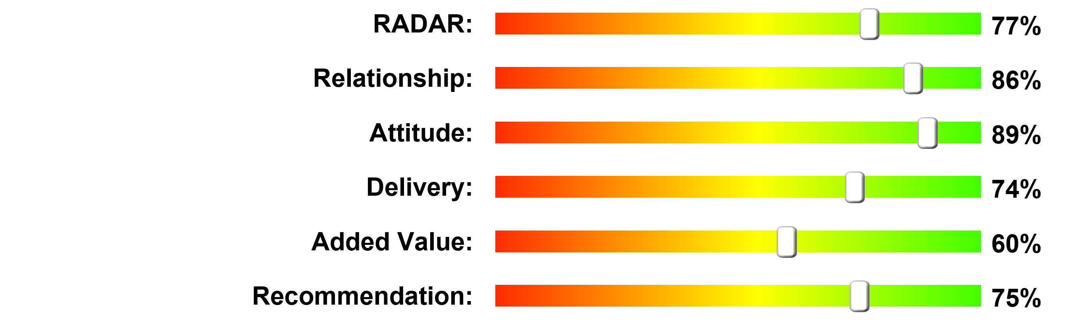
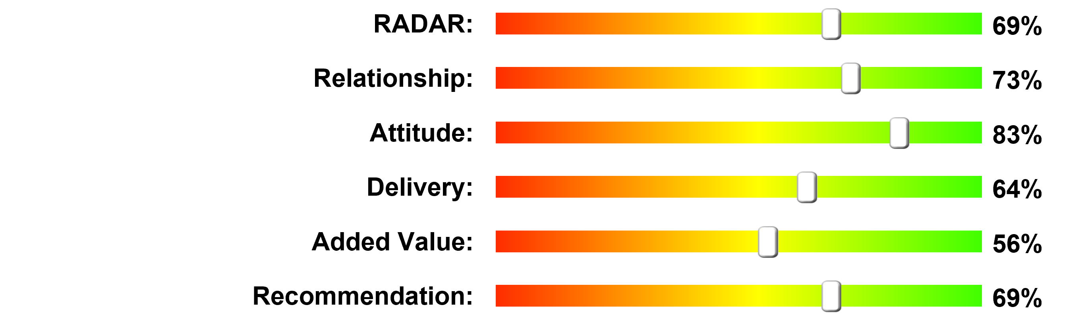
RADAR® Scores – Wave 3 vs Previous Waves
MWG Wave 1
MWG Wave 2 (2021)
MWG Wave 3 (2022)
© 2022 Relationship Audits & Management®

Slide 35
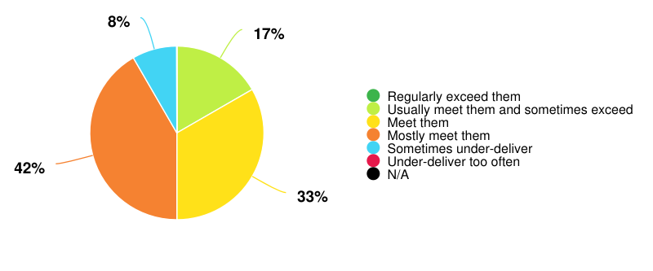
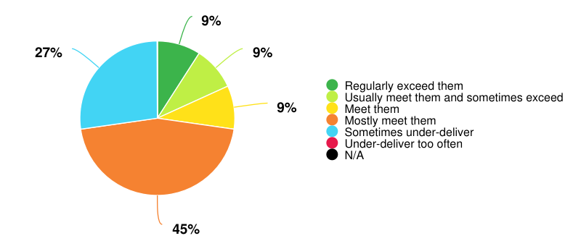
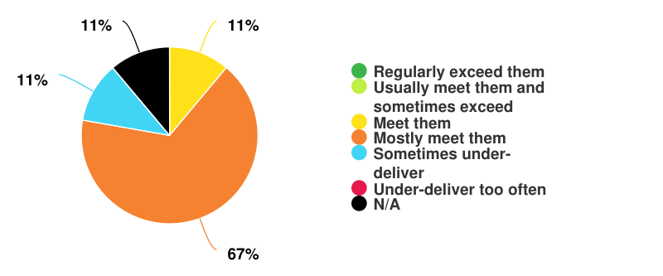
How do they deliver against expecations?
MWG Wave 1
MWG Wave 2
MWG Wave 3
© 2022 Relationship Audits & Management®

Slide 36
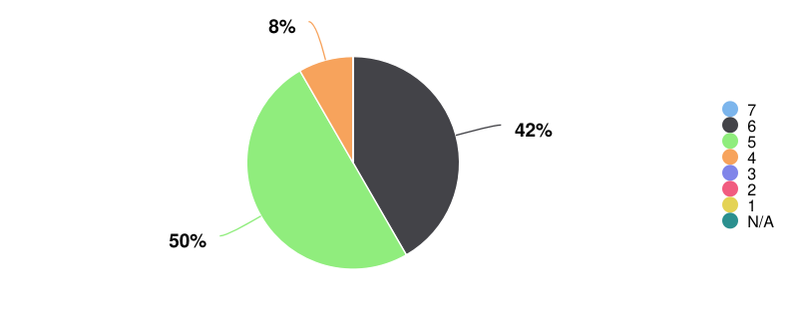
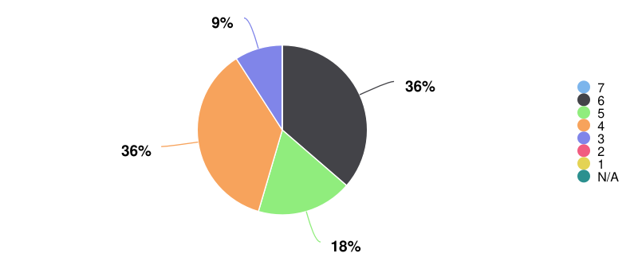
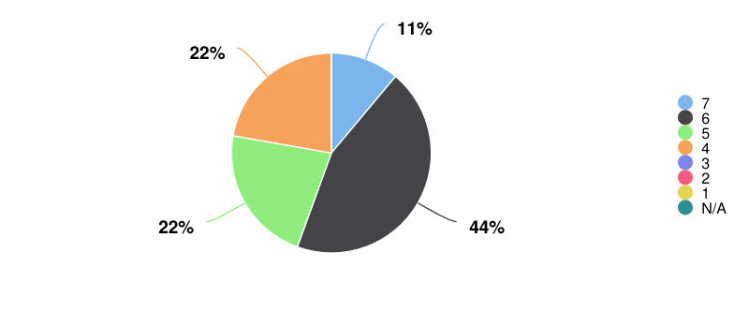
How would you score the agency overall?
(7 is high, 1 is low)
MWG Wave 1
MWG Wave 2
MWG Wave 3
© 2022 Relationship Audits & Management®

Slide 37
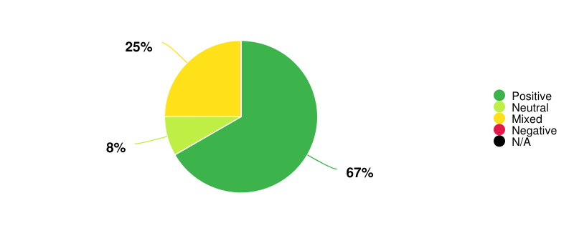
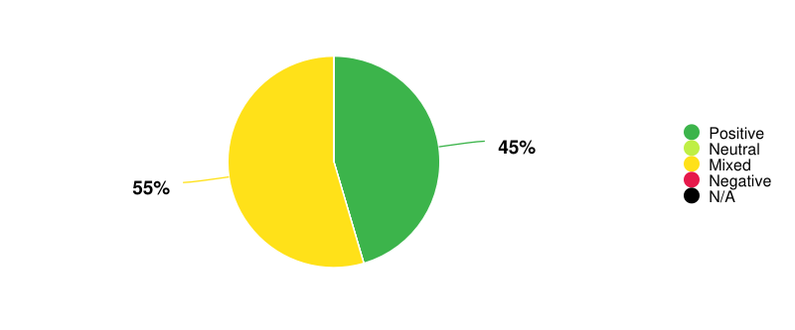
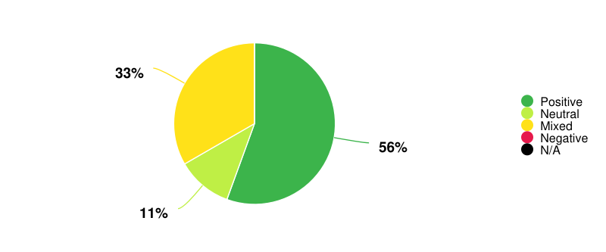
How would you sum up their reputation in your company?
MWG Wave 1
MWG Wave 2
MWG Wave 3
© 2022 Relationship Audits & Management®

Slide 38
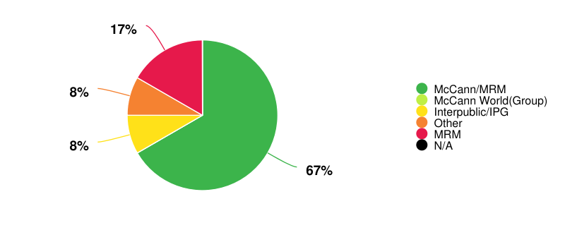
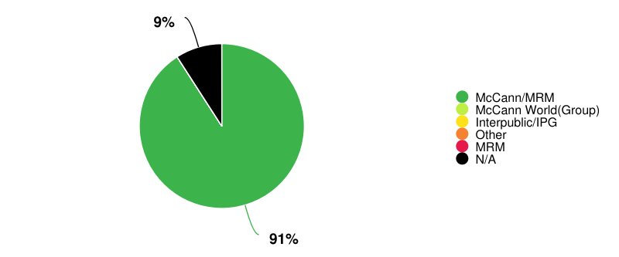
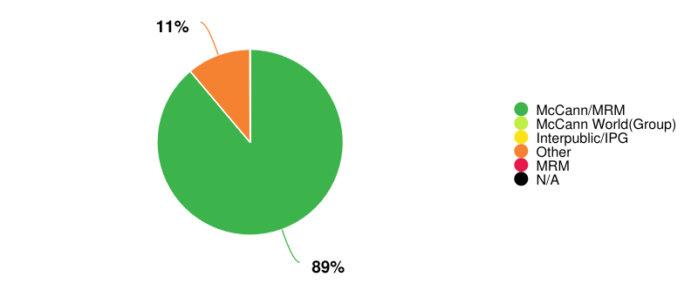
How do you refer to the Agency internally?
MWG Wave 1
MWG Wave 2
MWG Wave 3
© 2022 Relationship Audits & Management®

Slide 39
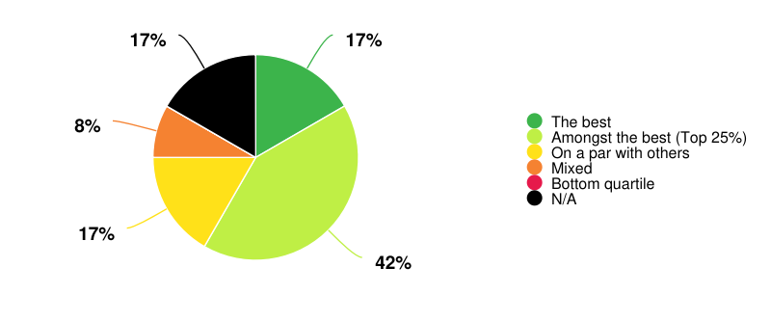
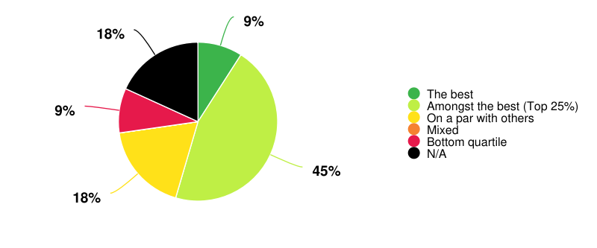
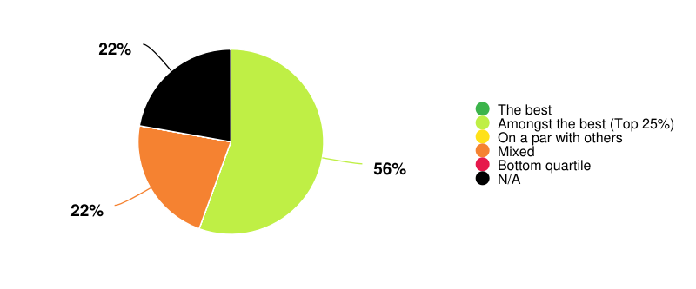
How does McCann compare with other agencies with whom you work?
MWG Wave 1
MWG Wave 2
MWG Wave 3
© 2022 Relationship Audits & Management®

Slide 40
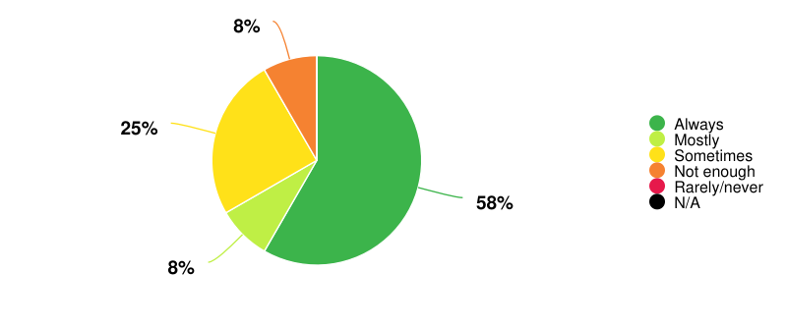
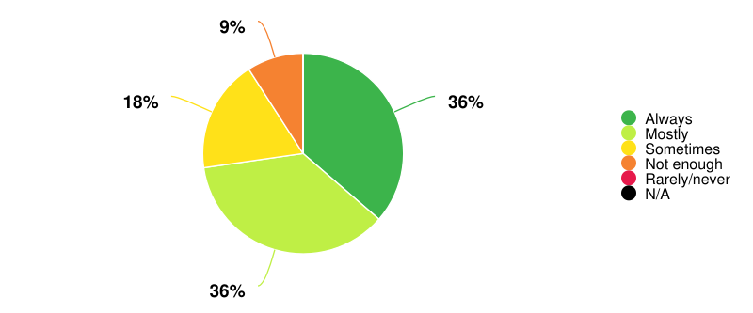
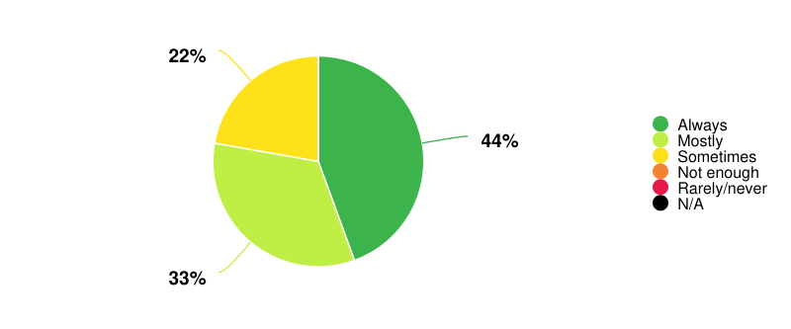
Is the team appropriately client centric and commercially aware?
MWG Wave 1
MWG Wave 2
MWG Wave 3
© 2022 Relationship Audits & Management®

Slide 41
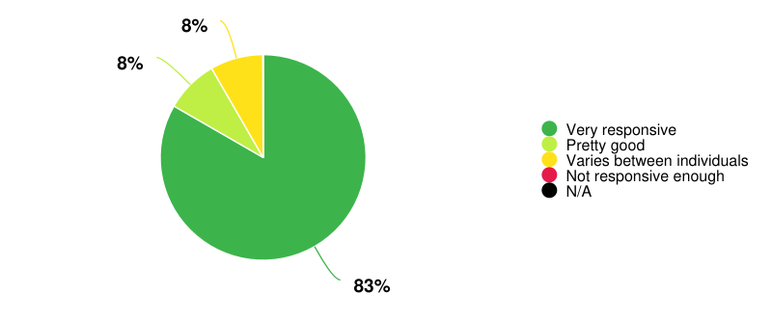
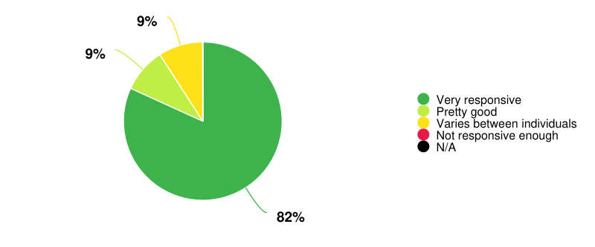
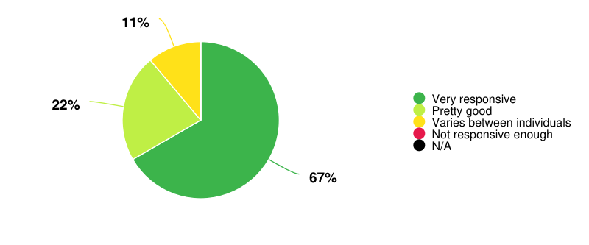
Is the team sufficiently responsive?
MWG Wave 1
MWG Wave 2
MWG Wave 3
© 2022 Relationship Audits & Management®

Slide 42
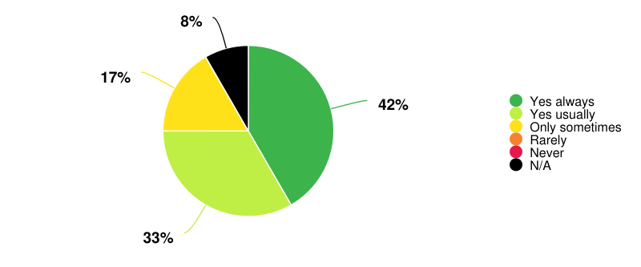
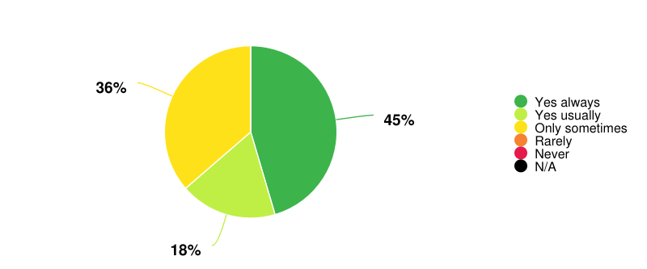
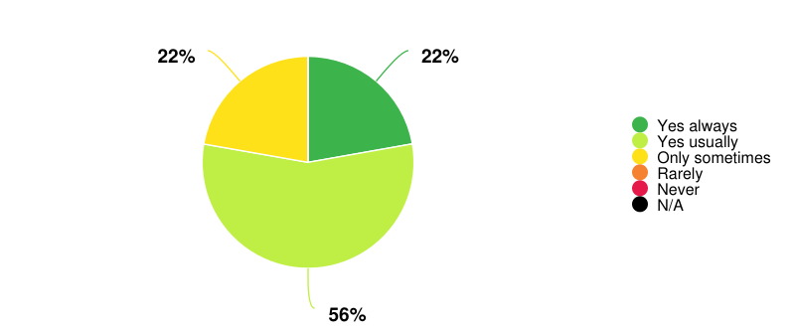
Is the team sufficiently adaptable and flexible?
MWG Wave 1
MWG Wave 2
MWG Wave 3
© 2022 Relationship Audits & Management®

Slide 43
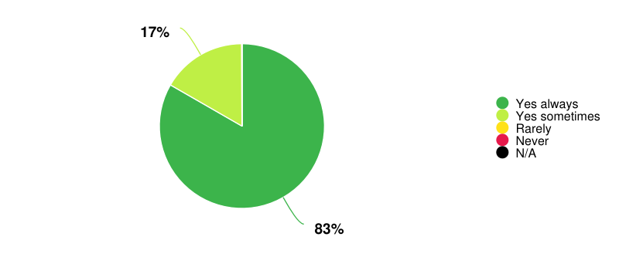

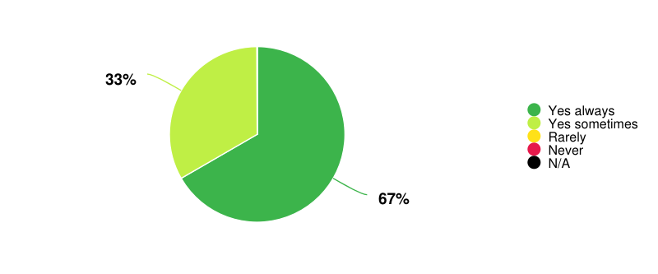
Does the team work with you in a collaborative way?
MWG Wave 1
MWG Wave 2
MWG Wave 3
© 2022 Relationship Audits & Management®

Slide 44
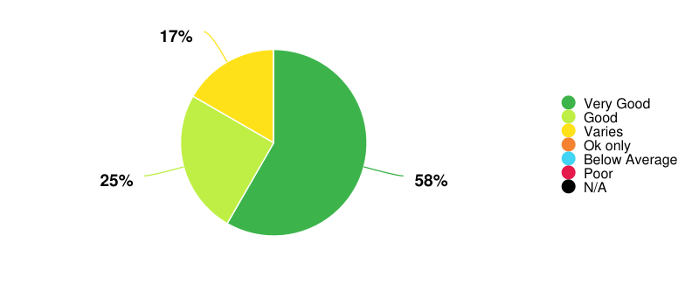
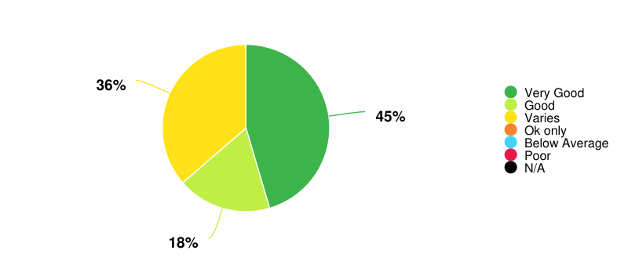
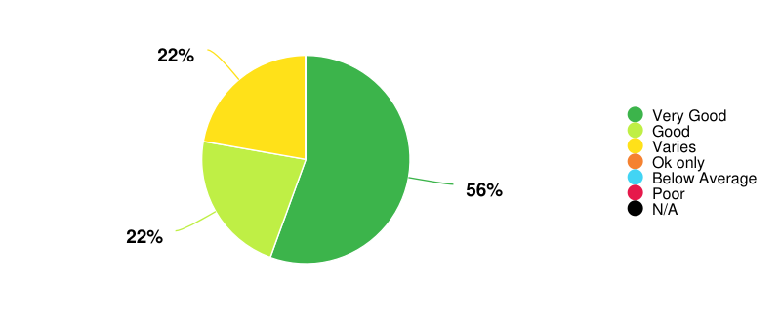
Quality of people, skills and resources
MWG Wave 1
MWG Wave 2
MWG Wave 3
© 2022 Relationship Audits & Management®

Slide 45
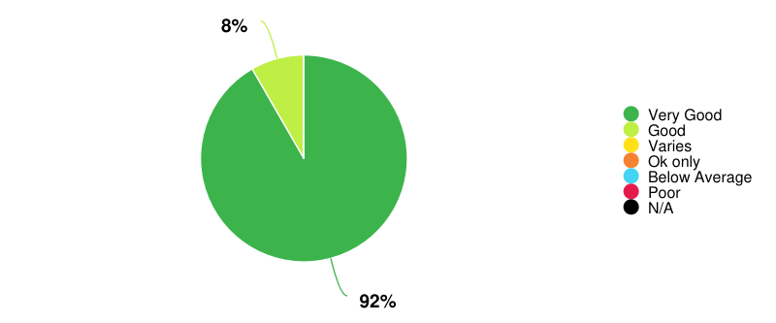
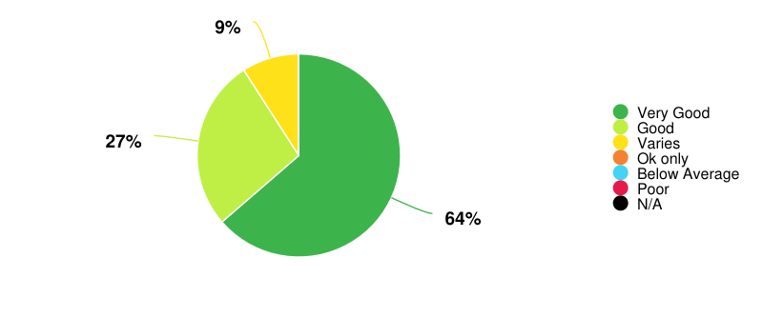
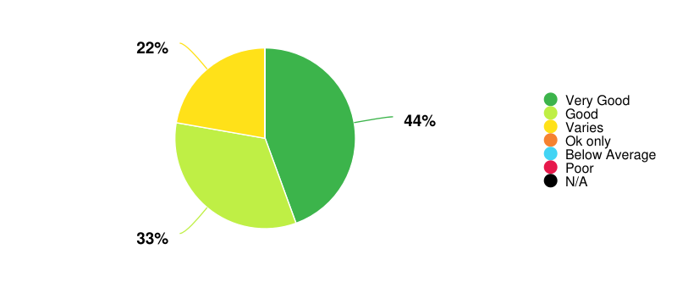
Chemistry and working relationships
MWG Wave 1
MWG Wave 2
MWG Wave 3
© 2022 Relationship Audits & Management®

Slide 46
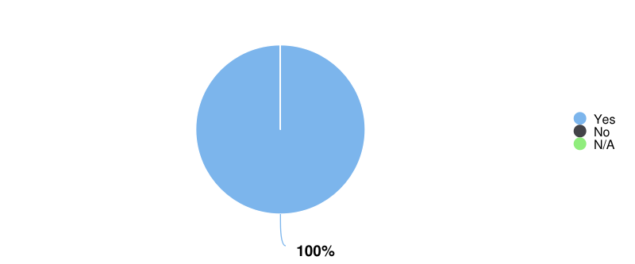
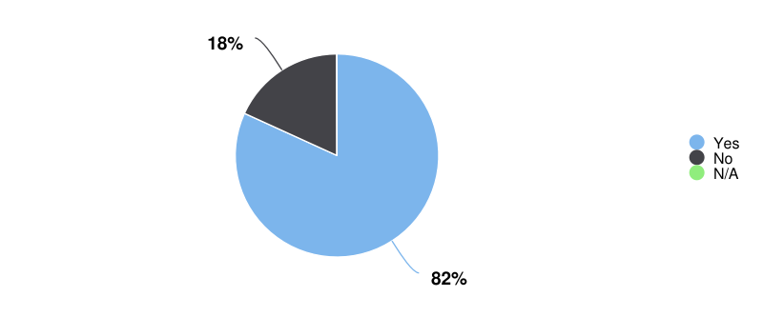
Any people doing an exceptional job?
MWG Wave 1
MWG Wave 2
MWG Wave 3
© 2022 Relationship Audits & Management®

Slide 47
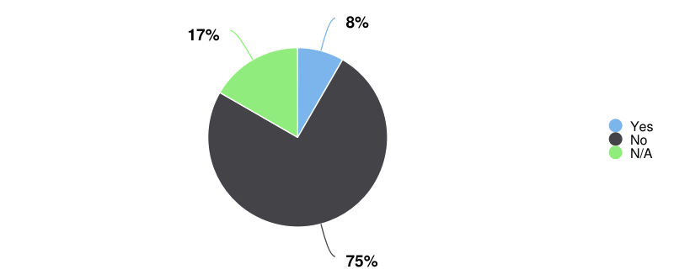
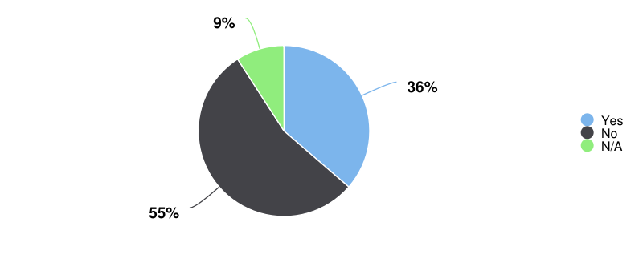
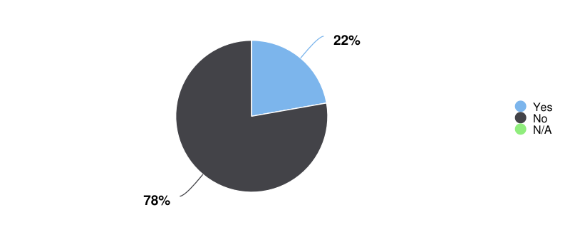
Any people underperforming?
MWG Wave 1
MWG Wave 2
MWG Wave 3
© 2022 Relationship Audits & Management®

Slide 48
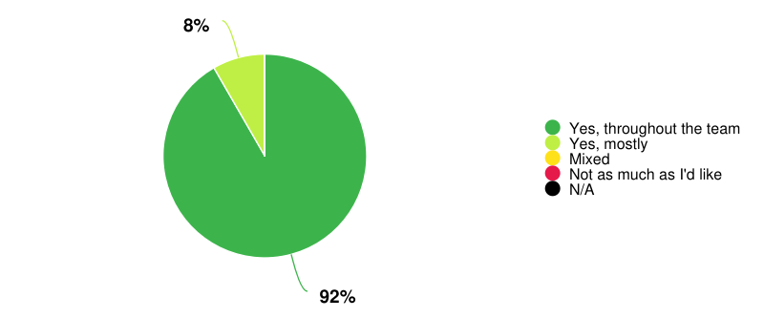
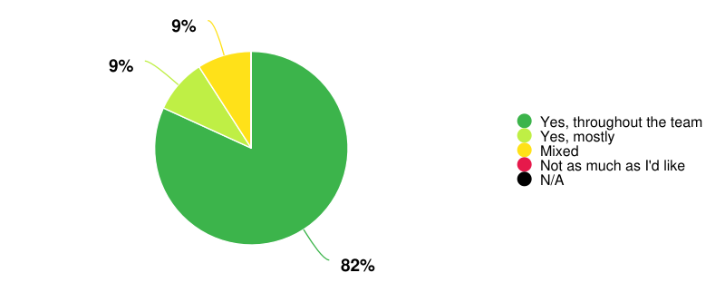
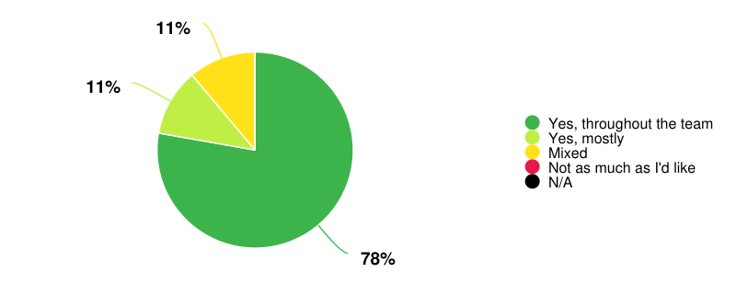
Is the team sufficiently accessible?
MWG Wave 1
MWG Wave 2
MWG Wave 3
© 2022 Relationship Audits & Management®

Slide 49
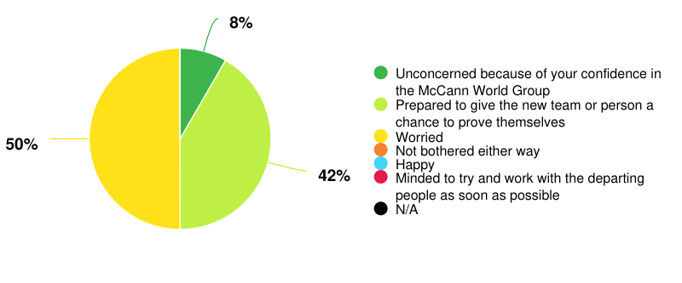


How would you feel if the key people on your account left?
MWG Wave 1
MWG Wave 2
MWG Wave 3
© 2022 Relationship Audits & Management®

Slide 50



How well does the agency understand your business?
MWG Wave 1
MWG Wave 2
MWG Wave 3
© 2022 Relationship Audits & Management®

Slide 51



Quality of strategic and creative input?
MWG Wave 1
MWG Wave 2
MWG Wave 3
© 2022 Relationship Audits & Management®

Slide 52



Quality of output?
MWG Wave 1
MWG Wave 2
MWG Wave 3
© 2022 Relationship Audits & Management®

Slide 53



Do they deliver on time and budget?
MWG Wave 1
MWG Wave 2
MWG Wave 3
© 2022 Relationship Audits & Management®

Slide 54


Quality of process and administration. How innovative are they?
MWG Wave 1
MWG Wave 2
MWG Wave 3
© 2022 Relationship Audits & Management®

Slide 55



How aware are you of the services McCann Worldgroup offers?
MWG Wave 1
MWG Wave 2
MWG Wave 3
© 2022 Relationship Audits & Management®

Slide 56



Would you like to know more of what McCann Worldgroup offer?
MWG Wave 1
MWG Wave 2
MWG Wave 3
© 2022 Relationship Audits & Management®

Slide 57



Does McCann add value or make a positive difference to your business?
MWG Wave 1
MWG Wave 2
MWG Wave 3
© 2022 Relationship Audits & Management®

Slide 58



Is the team at McCann Worldgroup sufficiently proactive?
MWG Wave 1
MWG Wave 2
MWG Wave 3
© 2022 Relationship Audits & Management®

Slide 59



Does McCann Worldgroup share learning and case studies from other clients that could be valuable for your business?
MWG Wave 1
MWG Wave 2
MWG Wave 3
© 2022 Relationship Audits & Management®

Slide 60



Do you feel a valued client?
MWG Wave 1
MWG Wave 2
MWG Wave 3
© 2022 Relationship Audits & Management®

Slide 61



How would you assess the value for money of working with McCann Worldgroup?
MWG Wave 1
MWG Wave 2
MWG Wave 3
© 2022 Relationship Audits & Management®

Slide 62



Would you recommend McCann Worldgroup?
MWG Wave 1
MWG Wave 2
MWG Wave 3
© 2022 Relationship Audits & Management®

Slide 63



Would you give them a testimonial?
MWG Wave 1
MWG Wave 2
MWG Wave 3
© 2022 Relationship Audits & Management®

Slide 64



How likely are you to give them any more assignments than they currently have?
MWG Wave 1
MWG Wave 2
MWG Wave 3
© 2022 Relationship Audits & Management®

Slide 65


Do you think you will still be working with McCann Worldgroup in 12 months’ time?
MWG Wave 1
MWG Wave 2
MWG Wave 3
© 2022 Relationship Audits & Management®

Slide 66



Do you think you will still be working with McCann Worldgroup in 24 months’ time?
MWG Wave 1
MWG Wave 2
MWG Wave 3
© 2022 Relationship Audits & Management®

Slide 67



Would you use them again if you went elsewhere?
MWG Wave 1
MWG Wave 2
MWG Wave 3
© 2022 Relationship Audits & Management®

Slide 68

Differences versus Wave 2
2. Difference 2
xx
© 2022 Relationship Audits & Management®

Slide 69

Differences versus Wave 2
3. Difference 3
xx
© 2022 Relationship Audits & Management®

Slide 70
Similarities versus Wave 2
1. Similarity 1
xx
© 2022 Relationship Audits & Management®

Slide 71
Similarities versus Wave 2
2. Similarity 2
xx
© 2022 Relationship Audits & Management®

Slide 72
Similarities versus Wave 2
3. Similarity 3
xx
© 2022 Relationship Audits & Management®

Slide 73
Similarities versus Wave 2
4. Similarity 4
xx
© 2022 Relationship Audits & Management®

Slide 74
Similarities versus Wave 2
5. Similarity 5
xx
© 2022 Relationship Audits & Management®

Slide 75
Similarities versus Wave 2
6. Similarity 6
xx
© 2022 Relationship Audits & Management®

Slide 76
3 Distinct Groups of Current Agency Performance
Maintain – Keep doing what you’re doing
Company?xx
Improve – ‘Hand on the tiller’
Company?xx
Transform – ‘Needs attention’
Company?xx
© 2022 Relationship Audits & Management®

Slide 77

Word Cloud
© 2022 Relationship Audits & Management®

Slide 78
One piece of advice
Three-word description
Animal personification
© 2022 Relationship Audits & Management®

Slide 79
One piece of advice and three word description
Client Company | Participant | One piece of advice | Three word description
Aramco | Kirk Collingwood | Behave globally | Relationship orientated Solution orientated Big idea orientated
Direct Line | Rabia Jaffer | Push the client harder (particularly on creative) | Reliable Expert Insightful
IKEA | Gabriel Ladaria | Stay ahead of your customer | Creative Added value Partner
Mastercard | Cristina Sacca | Be more transparent | Energy Intuition Ambition
© 2022 Relationship Audits & Management®

Slide 80
One piece of advice and three word description
Client Company | Participant | One piece of advice | Three word description
Microsoft | Michalis Moschos | 'Surprise me' | Partnership Care Discipline
Nespresso | Benjamin Combe | Should be stronger partners.. make more friends and bond better | Professional Expensive Heavy (not agile)
Reckitt Benckiser | Mathieu Desbrandes | 'Chill and listen more actively to feedback; and recognise that the agency has MD's trust | Good-brains (strategy and creative) Solution-focussed Chaotic
Reckitt Benckiser | Pankaj Duhan | Unearth the insight | Transparent Willing Action
X-Box | Michael Flatt | Stay humble and passionate and fight for ideas you believe in | Resilient Tenacious Humble
© 2022 Relationship Audits & Management®

Slide 81




Animal Personifications
Client Company | Participant | Animal | Animal Personification
Aramco | Kirk Collingwood | Hippo | They take a bit of time to get up and going, but when they do they build up a head of steam and charge in to the task
Direct Line | Rabia Jaffer | Domestic Cat | A reliable companion but without the energy of a dog
IKEA | Gabriel Ladaria | Cheetah | Beautiful speedy, fierce and aspirational
Mastercard | Cristina Sacca | Chameleon | Ability to adapt to challenging situations and move forward to be safe
© 2022 Relationship Audits & Management®

Slide 82





Animal Personifications
Client Company | Participant | Animal | Animal Personification
Microsoft | Michalis Moschos | Dog | A big family dog that is loyal and playful
Nespresso | Benjamin Combe | Elephant | Elegant smart.. heavy
Reckitt Benckiser | Mathieu Desbrandes | Cow | A medium-sized animal that is not agile
Reckitt Benckiser | Pankaj Duhan | Horse | A horse but now moving closer to a racehorse
X-Box | Michael Flatt | Lion | Tenacious and resilient and fight if they think it's worth it
© 2022 Relationship Audits & Management®

Slide 83
Overall Indicated Actions
Thank all clients for participating
Demonstrate that you have heard
Review which of the overall themes you feel you can address - and which not
Create a programme of regular ‘show and tell’ sessions with all clients
Use case studies to illustrate transferable learnings
Solicit the network for proven examples of innovative and successful use of
Social media
Digital media
New ‘always on’ platform
Use proactivity and initiatives to improve the value perception
Be more flexible in your pricing
not ‘one size fits all’
Develop action plans to address specific, ’by account’ issues
© 2022 Relationship Audits & Management®

Slide 84

Individual Reports

Slide 85
Individuals
Aramco - Kirk Collingwood
Direct Line - Rabia Jaffer
IKEA - Gabriel Ladaria
Mastercard - Cristina Sacca
Microsoft - Michalis Moschos
Nespresso - Benjamin Combe
Reckitt Benckiser - Mathieu Desbrandes
Reckitt Benckiser - Pankaj Duhan
X-Box - Michael Flatt
© 2022 Relationship Audits & Management®

Slide 86
Kirk Collingwood
Aramco - Kirk Collingwood

Slide 87
Interview Context
Worked with McCann for 4 years
© 2022 Relationship Audits & Management®

Slide 88

The Client Commitment Index® (Aramco)
(A) Kirk Collingwood
© 2022 Relationship Audits & Management®

Slide 89
RADAR® Analysis (Aramco)
© 2022 Relationship Audits & Management®

Slide 90
Expectations and Performance vs Overall Score
Expectations
Performance
Deliver multiple projects of different sorts
Act as brand guardians
Ability to flex and bring appropriate expertise as required
Mostly meet them
Overall Score
5/7
© 2022 Relationship Audits & Management®

Slide 91
Going Well
Needs Attention
Built a good integrated team
Client service operation good throughout
Good strategy function, taking ownership of roles across projects
Creative has ended up really good including the brand positioning
Net, very happy with performance and delivery
Be able to tap into required expertise more quickly
currently somewhat sluggish response times for both McCann network and IPG
Would like there to be good quality on the ground in Saudi
Seeming inability to access things more cost effectively from the network
e.g go where capabilities are cheaper and tap in to best value resource
Had challenges in campaign cultural acceptability in certain local markets
KC believes that McCann & IPG is not sufficiently integrated in to one team
Also, behind in the digital space. Need to develop material for channels rather then adapt for channels
© 2022 Relationship Audits & Management®

Slide 92
People
People doing an exceptional job
Nick manages projects and teams very well
"the answer is always 'yes'"
Tom 'very honest'
Ritu doing a great job and developed good media partnerships
but hamstrung by UM closing access to UM systems when she joined the world 7 team
People not performing well
UM has treated Aramco like a naive client
© 2022 Relationship Audits & Management®

Slide 93
Future
Continued growth of the downstream business, requiring new consumer products, which will put new demands on the business and require more access to local MWG offices
recent example is M&A activity help in Poland
© 2022 Relationship Audits & Management®

Slide 94
Three word description/one piece of advice
Three word description
One piece of advice
Relationship orientated
Solution orientated
Big idea orientated
Behave globally
© 2022 Relationship Audits & Management®

Slide 95

Animal Personification
A Hippo
They take a bit of time to get up and going, but when they do they build up a head of steam and charge in to the task
© 2022 Relationship Audits & Management®

Slide 96
Conclusions
A generally positive report, particularly on the core team but with some clear pointers for attention. He feels most of his expectations are being met and scores 5/7
He thinks
The agency has built a good integrated team and they have a good reputation in the company
they are accessible, responsive, flexible and collaborative
The client service and strategy elements are very good as have been the creative and brand positioning work.
Overall, he is very happy with performance and delivery
People performing well include Nick, Tom and Ritu and John
Moreover, he feels valued as a client and also that the agency has added value in the work done on brand positioning and would like the agency to now focus on what specific tactics go into the next campaign
© 2022 Relationship Audits & Management®

Slide 97
Conclusions Cont.
His key issues relate to
Turnaround time on projects
Expense (particularly production, where the agency seems to be reluctant to tap into the best value production locations)
The lack of a local MWG office in Saudi
The withdrawal of support and access to resource given by UM to Ritu given her role in the world 7 group
Proactivity, which is pretty low outside of the media partnerships work done by Ritu
Overall, he thinks the value for money of the client service and creative meets his expectations...but production costs don't
Nevertheless, he'd recommend without a caveat and give a testimonial(if spoken to) and anticipates still working together in 12 months but is not sure about 24 months given the upcoming RFP.
And if he went elsewhere, he would consider MWG based on the new company's footprint
MWG is very UK focused
© 2022 Relationship Audits & Management®

Slide 98
Indicated action
Thank him for participating
Congratulate those called out
Review the way UM operates and the opportunity to open a local office
Free up Ritu's access to UM's support services
Look at ways of speeding up turnaround times and sourcing production in better value markets
Get on the front foot more often with proactive suggestions, perhaps around the implications of a greater involvement in downstream activities
© 2022 Relationship Audits & Management®

Slide 99
Rabia Jaffer
Direct Line - Rabia Jaffer

Slide 100
Interview Context
With DLG for 8 years, working with MRM for 7 and 'owned' the relationship for 5 years
MRM retained the business retained the business three years ago
Recently been lots of MRM team change, not least losing Lucy who had led the business for a long time
Deals with Clare F monthly and account managers daily
Also has contact with mainstream agencies
© 2022 Relationship Audits & Management®

Slide 101

The Client Commitment Index® (Direct Line)
(A) Rabia Jaffer
© 2022 Relationship Audits & Management®

Slide 102
RADAR® Analysis (Direct Line)
© 2022 Relationship Audits & Management®

Slide 103
Expectations and Performance vs Overall Score
Expectations
Performance
To deliver high quality creative campaigns
Be a 'safe pair of hands'
Act as a strategic partner to also bring industry knowledge inside
Mostly meet them
Overall Score
6/7
© 2022 Relationship Audits & Management®

Slide 104
Going Well
Needs Attention
The know the brand, and process
Good industry insight including from other industries
Sharing knowledge of and training DLG in email marketing
Good bunch of people.. honest and open
If and when an error occurs, the client tends to find it
Sometimes the industry learning the agency brings cannot be acted upon by DLG
should actionability be a filter?
Opportunity to 'push the creative envelope'
© 2022 Relationship Audits & Management®

Slide 105
People
People doing an exceptional job
Harry Yung- longest serving account person was has become pivotal
People not performing well
But need a good replacement for the email manager
Key people - How would you feel if he/she/they left?
Worried
If Harry Yung left
© 2022 Relationship Audits & Management®

Slide 106
Future
DLG is becoming more data driven.
Increasingly the need will be for automation of process to deliver more 'thinking' rather than 'doing' time both internally and from partners
© 2022 Relationship Audits & Management®

Slide 107
Three word description/one piece of advice
Three word description
One piece of advice
Reliable
Expert
Insightful
Push the client harder(particularly on creative)
© 2022 Relationship Audits & Management®

Slide 108

Animal Personification
A domestic cat
A reliable companion but without the energy of a dog
© 2022 Relationship Audits & Management®

Slide 109
Conclusions
This is a positive report with some pointers for strengthening the relationship further
most of RJ's expectations are being met and she scores 6/7
On the plus side, the agency
understands the business, the industry, the brand and the process
has honest and open people who are collaborative responsive and flexible and also prepared to go the extra mile and in doing so, add value
e.g. email training
regular industry insights
wash-up sessions
Harry Yung mentioned as becoming pivotal and whose departure would cause RJ to be concerned given the recent staff churn
Feels the agency is good value for money (since the re-pitch)
very transparent rate card
© 2022 Relationship Audits & Management®

Slide 110
Conclusions Cont.
Developmentally,
If there's a mistake anywhere in the process, it’s typically the client who finds it
The insights are sometimes not practical to implement
The creative work is 'OK' but RJ would like the envelope to be pushed
RJ is hoping for a better email manager at the agency
Sometimes it's difficult to get hold of people by phone due to hybrid working
Would like to see more, and relevant proactivity
Notwithstanding the areas for attention, RJ
feels a valued client
would recommend and give a testimonial
envisages working together for the next 12 months
would actively consider MRM if she went elsewhere
© 2022 Relationship Audits & Management®

Slide 111
Indicated action
Thank her for participating
Congratulate HY
Keep behaving and doing much of what you have been but..
Improve the QC to catch mistakes
Use filter of 'practical application' on delivered industry insights
Push the creative envelope
Improve team accessibility
Use leveraged learning to help provide relevant proactivity
© 2022 Relationship Audits & Management®

Slide 112
Gabriel Ladaria
IKEA - Gabriel Ladaria

Slide 113
Interview Context
Second stint working with the agency
Working with Vicky, Marina, Maria and Lola
Also the lead country for a hub including France, Italy & Hungary
© 2022 Relationship Audits & Management®

Slide 114

The Client Commitment Index® (Ikea)
(A) Gabriel Ladaria
© 2022 Relationship Audits & Management®

Slide 115
RADAR® Analysis (Ikea)
© 2022 Relationship Audits & Management®

Slide 116
Expectations and Performance vs Overall Score
Expectations
Performance
Keep two steps ahead of Ikea
Develop strategic pathway for the product that pulls him out of his comfort zone
Deliver excellent creative quality
Be proactive - come to GL with ideas- not just about the brief
Mostly meet them
Overall Score
6/7
© 2022 Relationship Audits & Management®

Slide 117
Going Well
Needs Attention
Have developed a high quality strategy
Very high quality creative
Excellent client service- seen as part of the IKEA team
Team stability
Trustworthy
Digital capabilities
Need to think about their suitability
Avoid silos- Better integration with MRM
What is the tangible benefit of more integration?
© 2022 Relationship Audits & Management®

Slide 118
People
People doing an exceptional job
Miguel Mardiella a very nice guy who 'gets' the Ikea brand and is responsible for the last two briefs
Augustin has been excellent on strategy while Maria Goni has been missed and GL is pleased to see her back
Key people - How would you feel if he/she/they left?
Worried
Worried if Maria Goni were to disappear having returned after maternity leave
© 2022 Relationship Audits & Management®

Slide 119
Future
They will move to a system of 'briefing global with local application'
This may affect the hub system, but things are not yet fully clear
© 2022 Relationship Audits & Management®

Slide 120
Three word description/one piece of advice
Three word description
One piece of advice
Creative
Added value
Partner
Stay ahead of your customer
© 2022 Relationship Audits & Management®

Slide 121

Animal Personification
A cheetah
Beautiful speedy, fierce and aspirational
© 2022 Relationship Audits & Management®

Slide 122
Conclusions
This is a very positive report. The agency is meeting most of his expectations and on the way to meeting them all. Consequently, he'd score 6/7
He rates the stability of and client service from the whole agency team as well as the accessibility, chemistry, responsiveness, and trustworthiness of the individuals
He feels the agency is collaborative too, but that YMedia are probably better listeners
He also scores both strategy and creative work very highly
strategy has improved with the arrival of Augustin
He thinks the agency adds value by making the brand stronger but would still like more input in terms of IKEA's future direction
in fact, proactivity is an area in which there has been improvement but a little more would be welcome
and he'd like to see more examples of what the agency has done successfully for other clients that could be leveraged for IKEA
© 2022 Relationship Audits & Management®

Slide 123
Conclusions Cont.
There are no gross negatives though GL identified three areas for consideration going forward
Digital Capabilities
More integration with MRM
what are the tangible benefits beyond simply avoiding silos
keeping an eye on what the 'rebellious' brands are doing that could provide useful learning/inspiration
e.g PS 21 on KFC
Delivering on time and budget is now also good and the positive value perception will reman as long as production costs are controlled
which the independent production consultant has helped secure
He feels valued and would recommend, give a testimonial and envisages more business coming if MRM can brig initiatives to CRM
He expects to be working together in 24 months, and would ask the agency to pitch if he went elsewhere
© 2022 Relationship Audits & Management®

Slide 124
Indicated action
Thank him for participating
Big congratulations to the team
Keep doing what you have been but
turn up the proactivity a bit further
demonstrate active listening, more often
seek to deliver some real tangible benefits stemming from closer integration of McCann and MRM people
see if you can learn and leverage what the rebellious brands are up to
© 2022 Relationship Audits & Management®

Slide 125
Cristina Sacca
Mastercard - Cristina Sacca

Slide 126
Interview Context
Christina wanted a diverse team of talent across the European region rather than run from one place
She wanted a flexible structure composed of people who work well together
© 2022 Relationship Audits & Management®

Slide 127

The Client Commitment Index® (Mastercard)
(A) Cristina Sacca
© 2022 Relationship Audits & Management®

Slide 128
RADAR® Analysis (Mastercard)
© 2022 Relationship Audits & Management®

Slide 129
Expectations and Performance vs Overall Score
Expectations
Performance
Build awareness of what Mastercard really is
Strengthen the current position and elevate the brand
Create a positive spirit to create outstanding creative work
Mostly meet them
Overall Score
5/7
© 2022 Relationship Audits & Management®

Slide 130
Going Well
Needs Attention
Demonstrate the energy to keep things going
Great team, all trying to connect the dots,
e.g. talking to different audiences
flexibility to adapt to the morphing Mastercard
Fun to work with, good mix of personalities
Demonstrate willingness and capabilities to do things differently
Sometimes
They get a little stuck in old thinking, or
Do things driven by the local market that the brand wouldn't/shouldn't really do
They need to talk more amongst themselves to 'ring the bell' when being pressured to deliver local needs that are dissonant with desired brand comms
Don't be afraid to 'push me' to be (more) creative
© 2022 Relationship Audits & Management®

Slide 131
People
People doing an exceptional job
Luca the CD; understood what was required
Claudine.. CS liked her approach and thinking
© 2022 Relationship Audits & Management®

Slide 132
Future
The SOW will probably shrink because of the shift to more regional campaigns. Budgets are also under pressure and likely to shrink
© 2022 Relationship Audits & Management®

Slide 133
Three word description/one piece of advice
Three word description
One piece of advice
Energy
Intuition
Ambition
Be more transparent
© 2022 Relationship Audits & Management®

Slide 134

Animal Personification
Chameleon
Ability to adapt to challenging situations and move forward to be safe
© 2022 Relationship Audits & Management®

Slide 135
Conclusions
This is a generally very positive report, with some watch-outs
The agency is meeting most of her expectations and she scores 5.5 out of 7
She loves the team (chemistry & composition);
their energy collaborative and complementary skills;
their attitude, flexibility and patience in trying to navigate the Mastercard organisation;
and their attempts to join the dots of the communication matrix
CS volunteers that Mastercard is not an organisation with whom it is easy for an agency to work!
© 2022 Relationship Audits & Management®

Slide 136
Conclusions Cont.
Watch out areas include
speed of turnaround, with too much 'back and forth' pushing up costs and affecting value equation
being cajoled by local markets into doing things not appropriate for the overall brand
CS is looking for the agency to 'ring the bell' on those occasions
being over elaborate on strategic response sometimes, or stuck in old thinking when she wants a quick turnaround
not being afraid to push the creative envelope further
sometimes the agency seems to be rather overly aggressive in trying to increase budgets
she would love the agency to more proactively share and leverage their learning with other clients or regions
Nevertheless, she feels a valued client, would recommend unequivocally, give a testimonial and expects to be working with the agency for the next two years. There is potential for more revenue if the agency can demonstrate appropriate digital credentials and she would strongly consider using McCann again if she went to another similar organisation.
© 2022 Relationship Audits & Management®

Slide 137
Indicated action
Thank her for participating
Congratulate the team
Keep doing much of what you have been doing but
don't be afraid to push the creative envelope
improve turnaround times
leverage learning more
'ring the bell' if local markets make demands that conflict with overall brand direction
resist the temptation to ask for increases to the budget
© 2022 Relationship Audits & Management®

Slide 138
Michalis Moschos
Microsoft - Michalis Moschos

Slide 139
Interview Context
MM announced at the start of the call that he was changing roles to be more involved with the Partner community which would take him out of the direct MRM orbit but was happy discuss the agency relationship
MM thought the agency handled the transition from Raluca to Adi very well
© 2022 Relationship Audits & Management®

Slide 140

The Client Commitment Index® (Microsoft)
(A) Michalis Moschos
© 2022 Relationship Audits & Management®

Slide 141
RADAR® Analysis (Microsoft)
© 2022 Relationship Audits & Management®

Slide 142
Expectations and Performance vs Overall Score
Expectations
Performance
Managing the transition between Raluca to Adi
Maintaining stability and ensuring quality of deliverables
Demonstrate passion for the project
Meet them
Overall Score
6/7
© 2022 Relationship Audits & Management®

Slide 143
Going Well
Needs Attention
Think and act as a Partner
Nothing significant comes to mind
© 2022 Relationship Audits & Management®

Slide 144
People
People doing an exceptional job
Adi..who is a great partner and manager
He spotted an underachiever and dealt with it before he was asked to
© 2022 Relationship Audits & Management®

Slide 145
Future
Clearly, the agency will need to engage with MM's successor, though he doesn't see any major changes happening.. the environment will just continue to be very dynamic
He doesn't envisage any pressure on the budget at the moment
© 2022 Relationship Audits & Management®

Slide 146
Three word description/one piece of advice
Three word description
One piece of advice
Partnership
Care
Discipline
'Surprise me'
© 2022 Relationship Audits & Management®

Slide 147

Animal Personification
A dog
A big family dog that is loyal and playful
© 2022 Relationship Audits & Management®

Slide 148
Conclusions
A very positive report, reflected in expectations being met and an overall score of 6/7.
MM clearly sees the agency as a Partner with whom he would still like to engage even after his change of role
He rates Adi highly as a manager and a Partner and thinks the transition from Raluca was very well managed
He sees the agency as responsive, accessible, collaborative and client centric with good chemistry and people who understand his business
There are no gross negatives to fix, though there are two things which he would like to see more of
More proactivity, specifically sharing case studies/learning that could be repurposed for Microsoft's needs and examples of what MRM are doing for MS elsewhere
attending to some timeline challenges on localisation of executions
He feels valued as a client and as a result would recommend unequivocally. He envisages that MS will be working with MRM for the next two years and will look to find ways of engaging with the agency in his new role. Furthermore, If he left MS for another company, he would certainly consider MRM again.
© 2022 Relationship Audits & Management®

Slide 149
Indicated action
Thank him for participating - and keep in touch with him in his new role
Congratulate the team
Keep doing what you have been and
Be more proactive in sharing learning from other MRM clients as well as from other MRM/MS geographies
Look to improve at the timelines associated with localisation of executions
© 2022 Relationship Audits & Management®

Slide 150
Benjamin Combe
Nespresso - Benjamin Combe

Slide 151
Interview Context
2 years in Vevey, having previously worked with McCann in Montreal for 5 years
Now working with Stuart H, Clement, Neil, Charlotte
Daily contact with the McCann team
© 2022 Relationship Audits & Management®

Slide 152

The Client Commitment Index® (Nespresso)
(A) Benjamin Combe
© 2022 Relationship Audits & Management®

Slide 153
RADAR® Analysis (Nespresso)
© 2022 Relationship Audits & Management®

Slide 154
Expectations and Performance vs Overall Score
Expectations
Performance
Leverage their different talents from the network
Be able to demonstrate talent with real expertise in their field
Adequate resource
Need to challenge the frame
Mostly meet them
Overall Score
4/7
© 2022 Relationship Audits & Management®

Slide 155
Going Well
Needs Attention
Getting better framing and structure
The level of creativity is strong
Stuart has made a big (positive) difference
Not delivering digital
Staff turnover has been high and probably not enough
There was a period when, because Cedric was off, there was no Management and delays were happening everywhere
BC would like to better leverage the World Group's resources
© 2022 Relationship Audits & Management®

Slide 156
People
People doing an exceptional job
Neil has done a good job Stuart is doing well and Charlotte has supported in the last few months
People not performing well
Pierre Jon, Head of Digital
Key people - How would you feel if he/she/they left?
Worried
Concerned if Neil and, increasingly, Stuart left. The team needs stability
© 2022 Relationship Audits & Management®

Slide 157
Future
Business is challenging, which may turn into less money not more for the agency
Need to find new ways of working which optimises the budget
© 2022 Relationship Audits & Management®

Slide 158
Three word description/one piece of advice
Three word description
One piece of advice
Professional
Expensive
Heavy(not agile)
Should be stronger partners.. make more friends and bond better
© 2022 Relationship Audits & Management®

Slide 159

Animal Personification
Elephant:
Elegant smart..heavy
© 2022 Relationship Audits & Management®

Slide 160
Conclusions
A mixed report with issues to resolve but with new resource creating an upward trajectory
Most expectations are being me, but current score is at 4/7.
The key issue has been about resource, and the arrival of Stuart H has made a noticeable positive difference and he and Neil seem to be crucial Agency pillars now in the eyes of BC
Business understanding, chemistry, accessibility, collaboration, and responsiveness are all improving but there is still a way to go on /flexibility, strategic input and consistency of output
He also thinks the agency could be better at 'raising a flag' on delivery timings and budgets
He would like to see proactivity within and outside of the SOW and BC wants to be better able to leverage the resources of the World group to ensure he has access to top agency talent where-ever it is located
He is unimpressed with the agency's current 'digital capabilities'
© 2022 Relationship Audits & Management®

Slide 161
Conclusions Cont.
There is room to grow to make him feel valued as a client and the value for money is not seen to be there at the moment
'Paying a lot for not enough' and he is frustrated that 'so much time is spent negotiating fees’
Having said all this, he'd be prepared to recommend give a testimonial and envisages still working together in two years' time
But he's less sure if he would approach the agency were he to move to another company
© 2022 Relationship Audits & Management®

Slide 162
Indicated action
Thank him for participating
Congratulate Stuart and Neil
Continue to build on the recent improvements and also focus on digital capabilities and delivery
Leverage MWG where possible to effect change
© 2022 Relationship Audits & Management®

Slide 163
Mathieu Desbrandes
Reckitt Benckiser - Mathieu Desbrandes

Slide 164
Interview Context
Worked with the agency since Jan 2022, and been on Dettol for 3 years
Works with Katie, Mike K, Joe T, Harriet B and regular contact
Also works with M&C Saatchi
He recognises that RB are a difficult client with whom to work and that the agency has a genuine willingness to do well
© 2022 Relationship Audits & Management®

Slide 165

The Client Commitment Index® ( Reckitt Benckiser)
(A) Mathieu Desbrandes
© 2022 Relationship Audits & Management®

Slide 166
RADAR® Analysis (Reckitt Benckiser)
© 2022 Relationship Audits & Management®

Slide 167
Expectations and Performance vs Overall Score
Expectations
Performance
They have strong big agency credentials
Produce best in class creative comms
Develop 360 degree comms tool kit with (more) digital assets
Push boundaries where possible
Strong collaboration and partnership
Cost effective production
A partner who understands the business and maintains brand equity
Sometimes under-deliver
Overall Score
4/7
© 2022 Relationship Audits & Management®

Slide 168
Going Well
Needs Attention
Very strong first six months
Improved shopper tool kit
New strategist has added value
A good creative campaign (particularly, given the budget)
Taken on board feedback from last year
Katie is excellent, is a leader and understands business needs
Slippage in 2, so less happy in terms of
creative output
length of project turnaround
ways of working
Question marks over project management and ways of working
'Sometimes they are chaotic and the team overly 'needy'
Staff resource may not be sufficient
Need to listen better and know when to back off
'The agency sometimes disregards junior client level feedback'
Would like to see an upfront media strategist who embraces non TV focus
Resistance to new production techniques,
e. virtual shoots and associated budgets
© 2022 Relationship Audits & Management®

Slide 169
People
People doing an exceptional job
Katie, James, Harriet(who has recently been given more space and is a good listener)
Creatives Richard and Zac
Mel and James understand but A/M push back too much
People not performing well
But there seems to be insufficient resource
Key people - How would you feel if he/she/they left?
Worried
Worried if Katie were to leave
© 2022 Relationship Audits & Management®

Slide 170
Future
RB is trying to manage profitability which impacts both choice of media and number of campaigns. It's likely that RB will expect more for the same budget which may involve reengineering of process
© 2022 Relationship Audits & Management®

Slide 171
Three word description/one piece of advice
Three word description
One piece of advice
Good-brains(strategy and creative)
Solution-focused
Chaotic
'Chill and listen more actively to feedback; and recognise that the agency has MD's trust
© 2022 Relationship Audits & Management®

Slide 172

Animal Personification
A Cow
A medium-sized animal that is not agile
© 2022 Relationship Audits & Management®

Slide 173
Conclusions
A mixed picture with clear pointers for development, primarily around resource, project management, and listening
Upfront, MD did acknowledge that RB can be a difficult client
On the one hand, an extremely positive first half of the year when the agency was seen to respond well to last year's feedback
On the positive side
The new strategic resource has worked well
The creative campaign was good
The account has been well led by Katie
Good performances from the creative team, Harriet, Mel and James
© 2022 Relationship Audits & Management®

Slide 174
Conclusions Cont.
However, in the second half of the year MD has been less happy with
the available staff resource
project management and specifically speed of turnaround time and ways of working, which he described as 'sometimes chaotic' while the team appeared too 'needy'
the agency's listening skills
a perceived propensity to disregard the feedback of junior clients
agency flexibility
resistance to new production techniques
some (he referenced A/M) don't recognise when it's time to back down
more consistent collaboration which he sees as varying from 'yes, yes', to 'no, no'
As a consequence, he feels the agency is only meeting some of his expectations, so scores 4/7; while reputation is mixed at best and value for seen as below average
© 2022 Relationship Audits & Management®

Slide 175
Conclusions Cont.
He feels the agency does add value with its strategic input and creative output, but would like to see some more proactivity.
particularly leveraging learning from what the agency is doing with other clients and
taking a long term perspective on where the brand is headed
He also feels valued based on accessibility and the clear desire to make things work
So, he'd recommend and envisages working together in 12 months time(but is unsure of 24.)
If the identified issues can be fixed there may be an opportunity for more assignments especially orientated to the longer term
He would not give a testimonial to any agency, including McCann
© 2022 Relationship Audits & Management®

Slide 176
Indicated action
Thank him for participating
Congratulate those team members positively called out
Review the current team resource and look for ways to improve the project management and specifically turnaround times
Encourage greater awareness in the team of when to stop 'pushing back' and also merchandise a greater propensity to be seen to listen more to junior clients
Adopt a more consistent approach to collaboration and demonstrate a greater propensity to consider 'new' production techniques to improve value
© 2022 Relationship Audits & Management®

Slide 177
Pankaj Duhan
Reckitt Benckiser - Pankaj Duhan

Slide 178
Interview Context
Overall, a much better report than last year
Interacts regularly with Katie and Jessica
© 2022 Relationship Audits & Management®

Slide 179

The Client Commitment Index® ( Reckitt Benckiser)
(A) Pankaj Duhan 2
© 2022 Relationship Audits & Management®

Slide 180
RADAR® Analysis (Reckitt Benckiser)
© 2022 Relationship Audits & Management®

Slide 181
Expectations and Performance vs Overall Score
Expectations
Performance
Develop comms that break through the clutter of the diminishing presence of germs as a concern
Develop great insights to inform the creative work
Start with the UK and then move to other markets
Up the game in 'Digital and Social comms for the brand
Make the rest of the world less India reliant
set up pockets of creative development in Middle East & ASEAN
N/A
Overall Score
6/7
© 2022 Relationship Audits & Management®

Slide 182
Going Well
Needs Attention
Got the right people in the right places
KE has made 'a load of positive difference'
JT is still accessible
Indian team is very strong
Making progress on digital and social
Creating insights that drive emphasising continued relevance of germs needs to be accelerated
Crucial that both agency and client ensure the brand comms include not just TV but digital and social too
Would like more exposure to work in other markets
© 2022 Relationship Audits & Management®

Slide 183
People
People doing an exceptional job
Katie
'A great leader, proactive and stands her ground where necessary'
People not performing well
No-one. But PD wants the creative community to make a difference via insights
Key people - How would you feel if he/she/they left?
Worried
Katie and Jessica and Prasoua in India (and the strategic planner there)
© 2022 Relationship Audits & Management®

Slide 184
Future
The comms will need to become more digital which means the traditional model must evolve
© 2022 Relationship Audits & Management®

Slide 185
Three word description/one piece of advice
Three word description
One piece of advice
Transparent
Willing
Action
Unearth the insight
© 2022 Relationship Audits & Management®

Slide 186

Animal Personification
A horse but now moving closer to a racehorse
© 2022 Relationship Audits & Management®

Slide 187
Conclusions
Overall, a very positive report which testifies to a significant improvement vs 2021 and an overall score of 6/7
PD feels that the agency now has the right people in place and feels Katie is doing an excellent job while providing access to JT
The India head and strategist are also doing a good job
He feels the agency's reputation is positive in base media(TV) and now neutral in Digital
Going forward, he is looking for the agency to generate 'ahaa' insights to inform creative work that will cut through current consumer apathy toward 'germs'
He is looking for
the use of social and digital alongside mainstream media to make Dettol talked about like the 'noise' created for Durex
the creative to be 'mind or heart opening
for the creative hubs to be extended to the Middle East and ASEAN markets
© 2022 Relationship Audits & Management®

Slide 188
Conclusions Cont.
He rates
the quality of the people and chemistry
responsiveness collaborative approach and accessibility
flexibility in intent
and looking for flexibility in outcome (Mid East & ASEAN Creative resource)
the leadership and proactivity from Katie
He would like to see examples of good integration of digital/social that McCann has done for other clients/markets
As a result, PD feels valued, would recommend, envisages awarding more projects and expects to be working together in two years' time. He would also consider McCann if he went elsewhere.
© 2022 Relationship Audits & Management®

Slide 189
Indicated action
Thank him for participating
Congratulate the team
Focus on developing key insights to generate creative that will cut through post Covid germ apathy
Harness social and digital comms to work with trad TV to create 'noise' around the brand
Set up creative hubs in the Middle East and ASEAN markets
© 2022 Relationship Audits & Management®

Slide 190
Michael Flatt
X-Box - Michael Flatt

Slide 191
Interview Context
13 years working with McCann over two stints
Works with Sail, Melanie, Sophie, Hania, JJ, Sanjiv and Jamie
Also works with Assembly for PR & Social
© 2022 Relationship Audits & Management®

Slide 192

The Client Commitment Index® (X-Box)
(A) X-Box
© 2022 Relationship Audits & Management®

Slide 193

The Client Commitment Index® (X-Box)
(A) Michael Flatt
© 2022 Relationship Audits & Management®

Slide 194
RADAR® Analysis (X-Box)
© 2022 Relationship Audits & Management®

Slide 195
Expectations and Performance vs Overall Score
Expectations
Performance
Develop brilliant ideas
Have the systems and people to work with a complicated multinational in terms of placement of comms
Be across the detail
Be resilient
Mostly meet them
Overall Score
7/7
© 2022 Relationship Audits & Management®

Slide 196
Going Well
Needs Attention
Done very well on creative ideas since 2016
contributed to Microsoft success at Cannes
Constantly thinking proactively about new ideas
Impressively energetic and resilient Account Management
Good planning
Good listening skills
Good access to senior team
MF can be honest with them
Sometimes need help in deploying ideas across Social Media
Expensive global ratecard (which may need attention)
© 2022 Relationship Audits & Management®

Slide 197
People
People doing an exceptional job
The whole team is doing a great job
Key people - How would you feel if he/she/they left?
Worried
If Jamie and Sanjiv left...
© 2022 Relationship Audits & Management®

Slide 198
Future
Acquisition of Activision /Blizzard was very expensive and MF may be asked to review budgets
There may be a movement for Microsoft away from being a console business to be an online gaming service (c.f Netfix)
This could impact the way that MS works with agency partners
© 2022 Relationship Audits & Management®

Slide 199
Three word description/one piece of advice
Three word description
One piece of advice
Resilient
Tenacious
Humble
Stay humble and passionate and fight for ideas you believe in
© 2022 Relationship Audits & Management®

Slide 200

Animal Personification
Lion
Tenacious and resilient and fight if they think it's worth it
© 2022 Relationship Audits & Management®

Slide 201
Conclusions
A very good report.. The agency is meeting most of MF's expectations and he scores 7/7!
MF clearly loves working with the agency and feels he has a great team who produce high quality creative work
The chemistry is very good and MF values the energy and resilience of the team, their listing skills, their responsiveness, their knowledge of the business, their flexibility, accessibility and their proactivity
While they work collaboratively with MF, he feels both MU and Assembly could work together better
In fact, he feels that sometimes the agency does need help to develop ideas across social media
In addition, he feels that the agency needs to be better at providing scope for new projects...'check before they spend'
While having a positive reputation internally, the agency is clearly seen as expensive and this may have an impact on future budgets given the recent acquisition of Activision Blizzard
Right now, MF feels a valued client, would recommend and give a testimonial and is likely to give more business in the short term(12 months) but is not sure about the landscape in 24 months
If he left MS, MF would certainly consider McCann in his next role
© 2022 Relationship Audits & Management®

Slide 202
Indicated action
Thank him for participating
Congratulate the team
Keep doing much of you have been but
try harder to engage with Assembly over social
be clearer about scope and costs
be prepared for budget cuts based on the current rate card
© 2022 Relationship Audits & Management®

Slide 203
Quantitative Data

Slide 204

How well do they deliver against your expectations?
How would you score the agency overall?
(7 is high and 1 is low)
© 2022 Relationship Audits & Management®

Slide 205


How would you sum up their reputation in your company?
How does McCann compare with other agencies with whom you work?
© 2022 Relationship Audits & Management®

Slide 206


Is the team appropriately client centric and commercially aware?
Is the team sufficiently responsive?
© 2022 Relationship Audits & Management®

Slide 207


Is the team sufficiently adaptable and flexible??
Does the team work with you in a collaborative way?
© 2022 Relationship Audits & Management®

Slide 208


Quality of people, skills and resources
Chemistry and working relationships
© 2022 Relationship Audits & Management®

Slide 209


Any people doing an exceptional job?
Any people underperforming?
© 2022 Relationship Audits & Management®

Slide 210


How would you feel if the key people on your account left?
Is the team sufficiently accessible?
© 2022 Relationship Audits & Management®

Slide 211


How well does the agency understand your business?
Quality of strategic and creative input?
© 2022 Relationship Audits & Management®

Slide 212


Quality of output ?
Do they deliver on time and budget?
© 2022 Relationship Audits & Management®

Slide 213


How aware are you of the services McCann Worldgroup offers?
Would you like to know more of what McCann Worldgroup offer?
© 2022 Relationship Audits & Management®

Slide 214


Does McCann add value or make a positive difference to your business?
Is the team at McCann Worldgroup sufficiently proactive?
© 2022 Relationship Audits & Management®

Slide 215


Does McCann Worldgroup share learning and case studies from other clients that could be valuable for your business?
Do you feel a valued client?
© 2022 Relationship Audits & Management®

Slide 216


How would you assess the value for money of working with McCann Worldgroup?
Would you recommend McCann Worldgroup?
© 2022 Relationship Audits & Management®

Slide 217


How likely are you to give them any more assignments than they currently have?
Would you give them a testimonial?
© 2022 Relationship Audits & Management®

Slide 218


Do you think you will still be working with McCann Worldgroup in 12 months’ time?
How about 24 months?
© 2022 Relationship Audits & Management®

Slide 219

Would you use them again if you went elsewhere?
© 2022 Relationship Audits & Management®

